Slide 1
Domain Models
COMP 3711
Larman: Chapter 9

Slide 2
Objectives
Identify the conceptual classes from the Use Cases in the first iteration of the Elaboration phase
Create the Domain Model
Add the attributes and the associations to the classes in the Domain Model

Slide 3
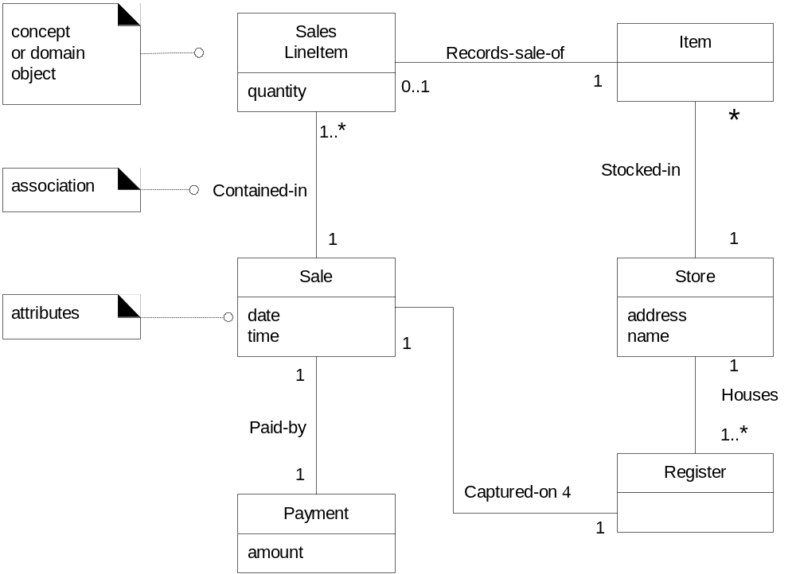
What is a domain model?
A domain model is a representation of real world conceptual classes, not of software components.
Meaningful classes in a problem domain

Slide 4
Domain Models
Also known as conceptual models, domain object models, or analysis object models
A visual representation of conceptual classes or real-world objects in a domain of interest
A visual dictionary of the noteworthy abstractions (conceptual classes), domain vocabulary, and information content of the domain

Slide 5
UML representation of Domain Model
Using UML notation, a domain model is illustrated using a set of class diagrams with:
  Conceptual classes
  Attributes of conceptual classes
  No operations
  Associations between conceptual classes

Slide 6
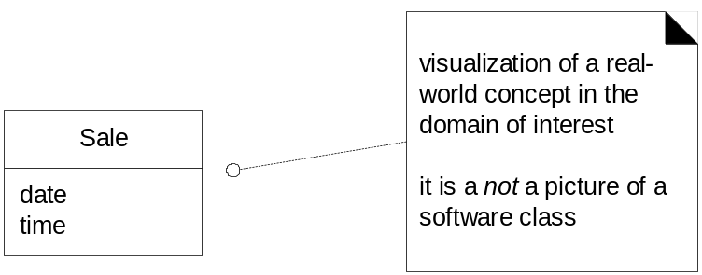
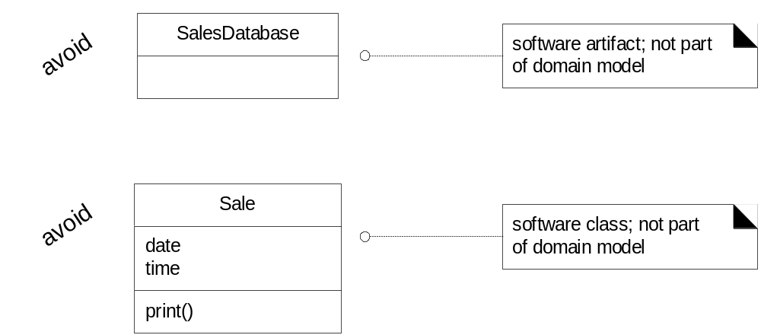
Domain Models and software
Domain model is a visualization of things in the real world domain, not of software components such as Java & C++.

Slide 7
Domain Models and decomposition
Problem ➔ Software problems can be complex.
Solution ➔ Decompose or Divide-and-conquer
The dimension of decomposition is by entities (objects) in the domain.

Slide 8
Conceptual Class Identification
Incrementally build a domain model over several iterations in the elaboration phase
In each phase, the domain model is limited to the prior and current scenarios under consideration
Central task is to identify conceptual classes related to the scenario under consideration
It is better to over-specify a domain model with lots of fine-grained conceptual classes than to under-specify it.
It is valid to have conceptual classes without attributes which have purely behavioral role

Slide 9
Strategies to identify conceptual classes
Use conceptual class category list
  See next slide ….
Identify noun phrases in textual descriptions
  Fully dressed use cases are an excellent description to draw from

Slide 10
Conceptual Class Category | Examples
Physical or tangible objects | Register, Airplane
Specifications, designs, or descriptions | ProductSpecification, FlightDescription
Places | Store, Airport
Transactions | Sale, Payment, Reservation
Transaction line items | SaleLineItem
Roles of people | Cashier, Pilot
Containers of other things | Store, Bin, Airplane
Things in a container | Item, Passenger
Other external systems | CCPaymentSystem, AirTrafficControl
Abstract noun concepts | Hunger, Acrophobianger
Organizations | SalesDepartment, SuperAirline
Events | Sale, Payment, Meeting, Flight, Landing
Processes | SellingAProduct, BookinhASeat
Rules and policies | RefundPolicy, CancellationPolicy
Catalogs | ProductCatalog, PartsCatalog
Records of finance, work, contracts, legal | Receipt, Ledger, EmploymentContract
Financial instruments and services | LineOfCredit, Stock
Manuals, Documents, Reference Papers | DailyPriceChangeList, RepairManual

Slide 11
Conceptual classes from nouns
Simple cash-only Process Sale scenario:
Customer arrives at a POS checkout with goods and/or services to purchase.
Cashier starts a new sale.
Cashier enters item identifier and quantity, if greater than one.
System records sale line item and presents item description, price, and running total.
Cashier repeats steps 2-3 until indicates done.
System presents total with taxes calculated.
Cashier tells Customer the total, and asks for payment.
Customer pays with cash.
Cashier enters cash tendered.
System records payment and presents change due.
System logs the completed sale, but does not interact with external systems.
System presents receipt.
Customer leaves with receipt and goods.

Slide 12
Candidate conceptual classes for the Sales domain.
Register
Item
Store
Sale
Sales
LineItem
Cashier
Customer
Manager
Product
Catalog
Product
Specification
Payment
This is, somewhat, an arbitrary list of abstractions that the modelers consider noteworthy

Slide 13
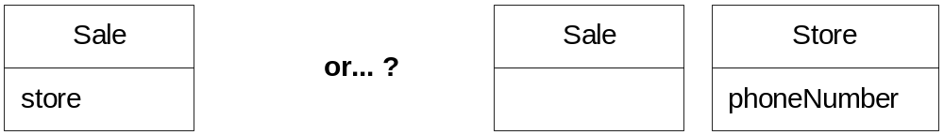
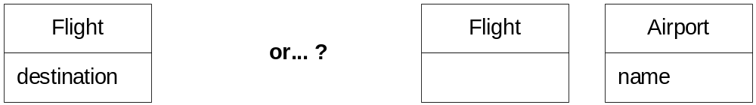
Common mistake in identifying classes
Representing something as an attribute when it should be a conceptual class

Slide 14
Resolve similar conceptual classes
Sometimes, two classes represent the same thing in a particular domain:
  Register & (P)oint (O)f (S)ale (T)erminal
  Item & Product
  Customer & Client
  Outlet & Shop
Decide upon which class identifier is to be used and stick to it.

Slide 15
Domain Modeling Guidelines
List the candidate conceptual classes using following techniques:
  Conceptual Class Category List
  and/or Noun Phrase Identification
Draw them in a domain model
Add associations necessary to record relationships
Add the attributes necessary to fulfill information requirements

Slide 16
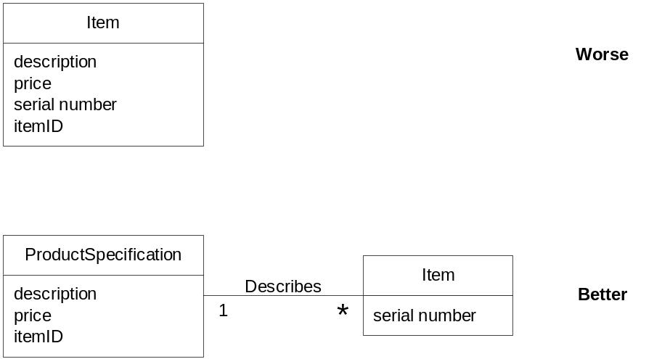
Specification Conceptual Classes
Add specification conceptual class when:
There needs to be a description about an item or service, independent of the existence of those items or services
Deleting instances of things they describes results in a loss of information
Reduced duplicated information

Slide 17
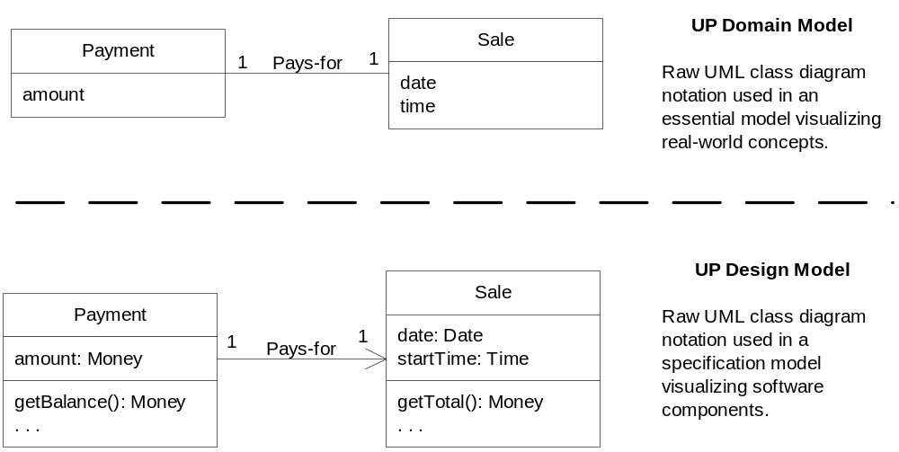
Domain Model versus Class Diagram
When UML boxes are drawn in the Domain Model, they are called conceptual classes (or domain concepts)
When UML boxes are drawn in the Design Model, they are called design classes.

Slide 18
Class related terms
Conceptual Class | Real-world concept or thing
Software Class | A class representing a specification or implementation perspective of a software component
Design Class | A class in the design model
Implementation Class | A class implemented in an OO language such as Java
Class | The general term representing either a real-world or software thing

Slide 19
UP & Domain Models
Discipline | Artifact | Inception | Elaboration | Construction | Transition
Business Modeling | Domain Model |  | start
Requirements | Use-Case Model | start | refine
 | Vision | start | refine
 | Supplementary Specification | start | refine
 | Glossary | start | refine
Design | Design Model |  | start | refine
 | SW Architecture Document |  | start | refine
 | Data Model |  | start | refine
Implementation | Implementation Model |  | start | refine | refine
Project Management | SW Development Plan | start | refine | refine | refine
Testing | Test Model |  | start | refine
Environment | Development Case | start | refine
Domain models normally started and completed in elaboration

Slide 20
Questions and Conclusions

